Slide 1
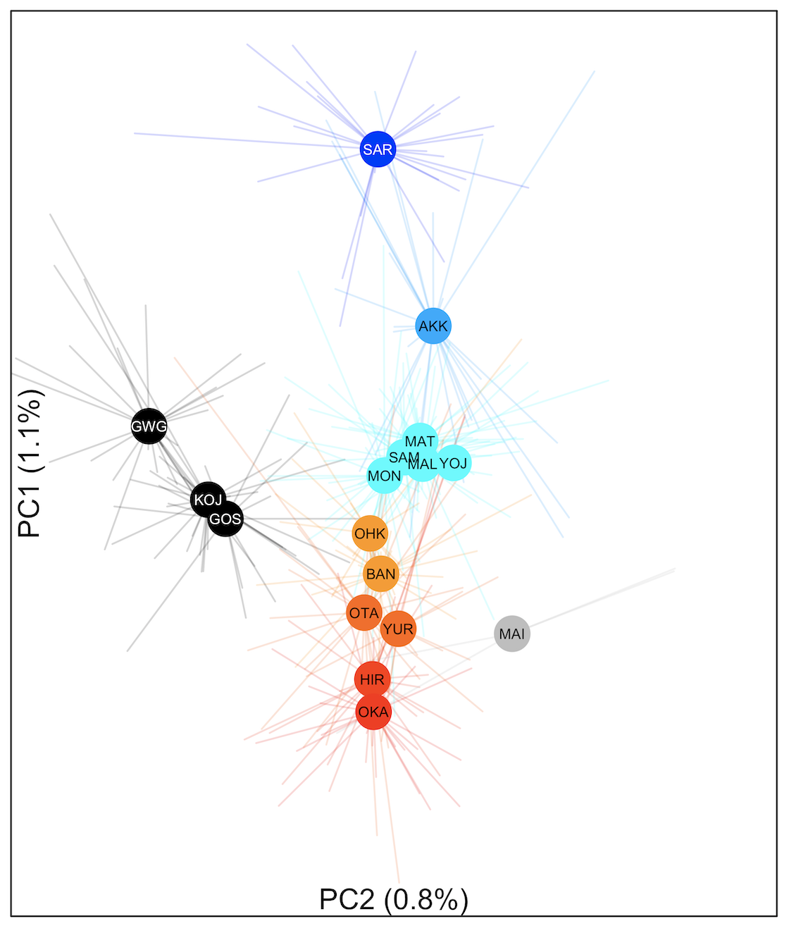
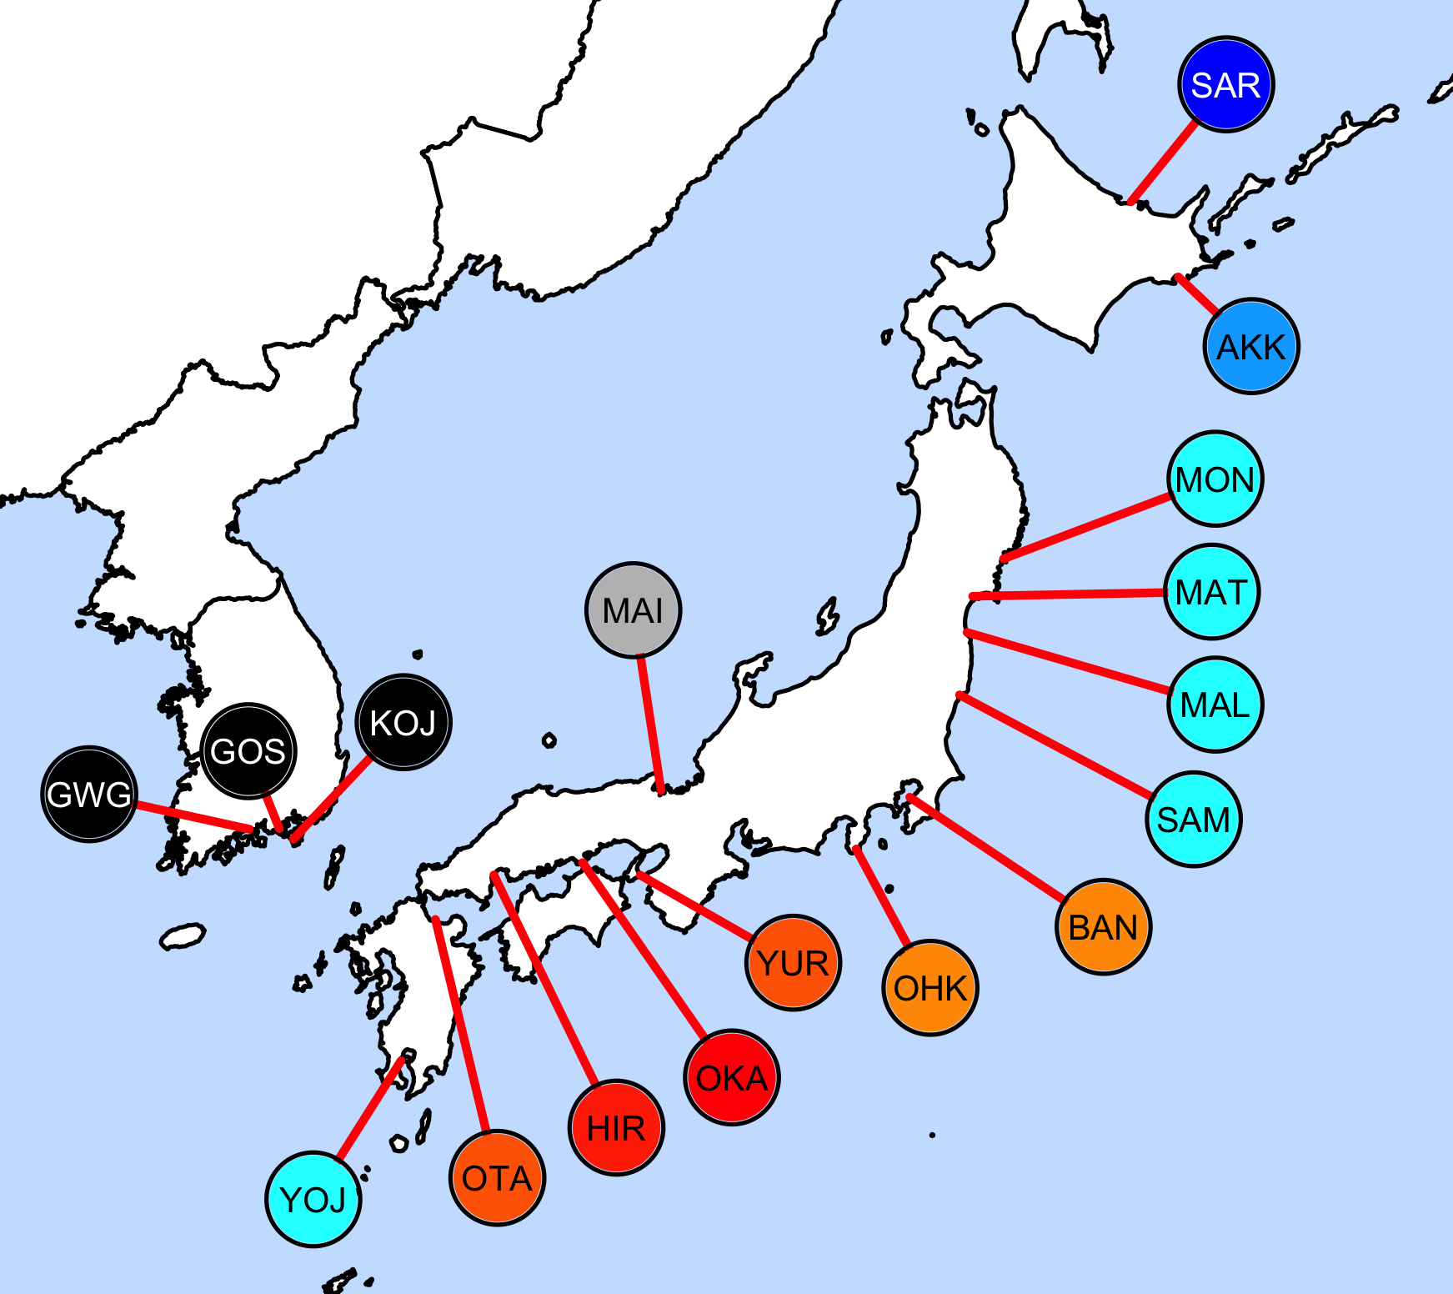
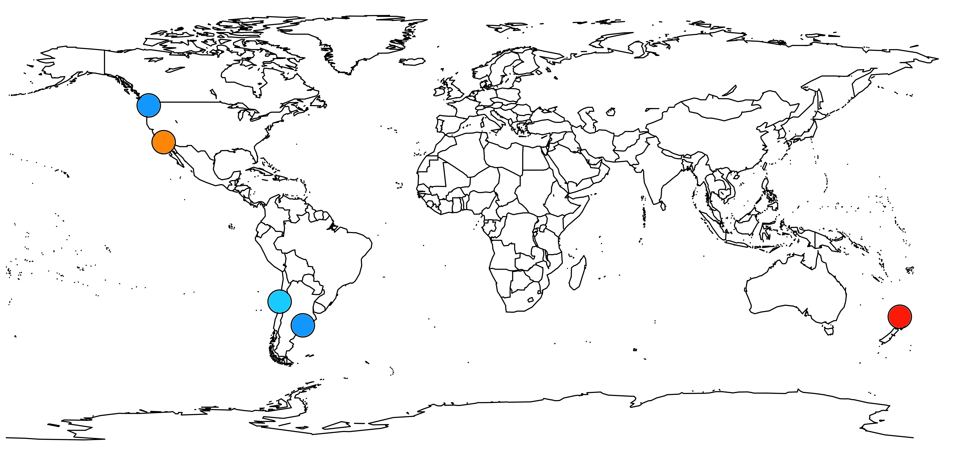
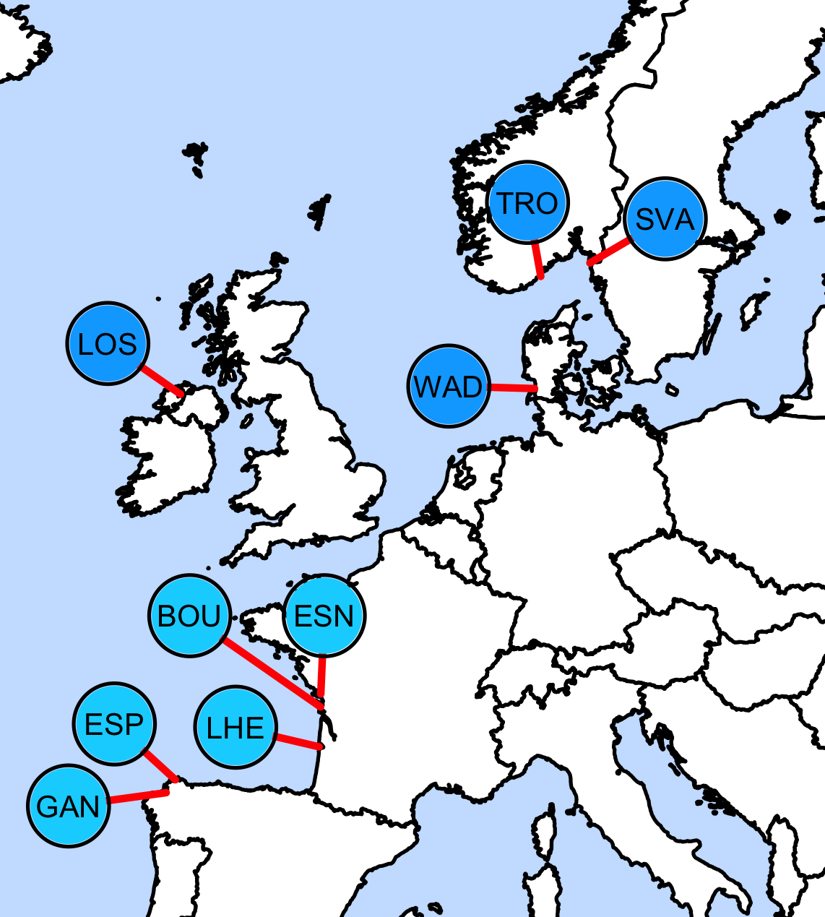
Figure 1. A) Principal components analysis (PCA) trained with native oysters from Korea and Japan. Population colors reflect a blue-to-red gradient from the 1st axis of the PCA. Populations are mapped onto geography in B) Japan and Korea and C) worldwide. Regional locations of three native oyster strains (sensu Imai and Sakai 1961) are indicated.
A
B
Hokkaido
Hokkaido
Miyagi
Miyagi
Hiroshima
Hiroshima
C
Canada and WA
Europe
Native range
See B
California
Chile
Argentina
New Zealand

Slide 2
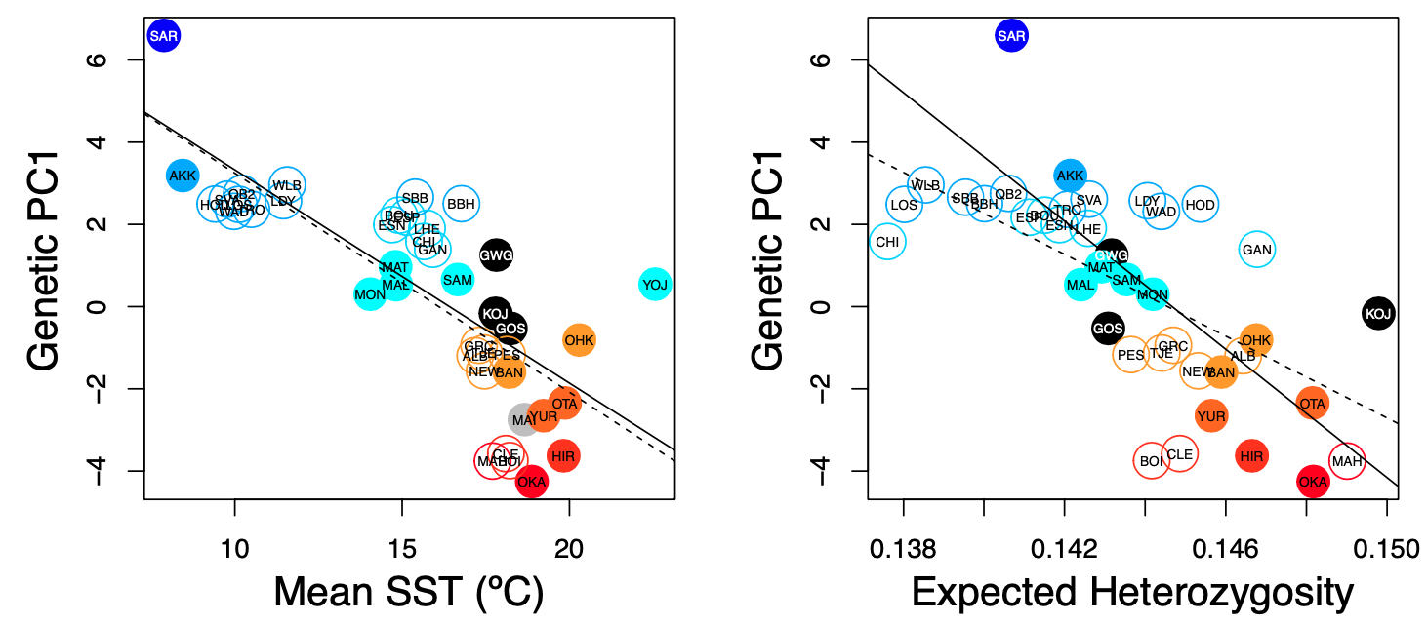
Figure 2. Genetic PC1 correlates with mean sea surface temperature (Native r = -0.777; df = 15; p< 0.001; Introduced r = -0.744; df = 22; p< 0.001) and with expected heterozygosity (Hs; Native r = -0.755, df = 13, p = 0.001; Introduced r = -0.634, df = 22; p < 0.001). Closed versus open circles represent native versus introduced populations, respectively. Population colors reflect a blue-to-red gradient of Genetic PC1 (Fig 1a).

Slide 3
Supplemental

Slide 4
Figure S2 – Principal components analysis (PCA) of 726 oysters using 7046 loci

Slide 5
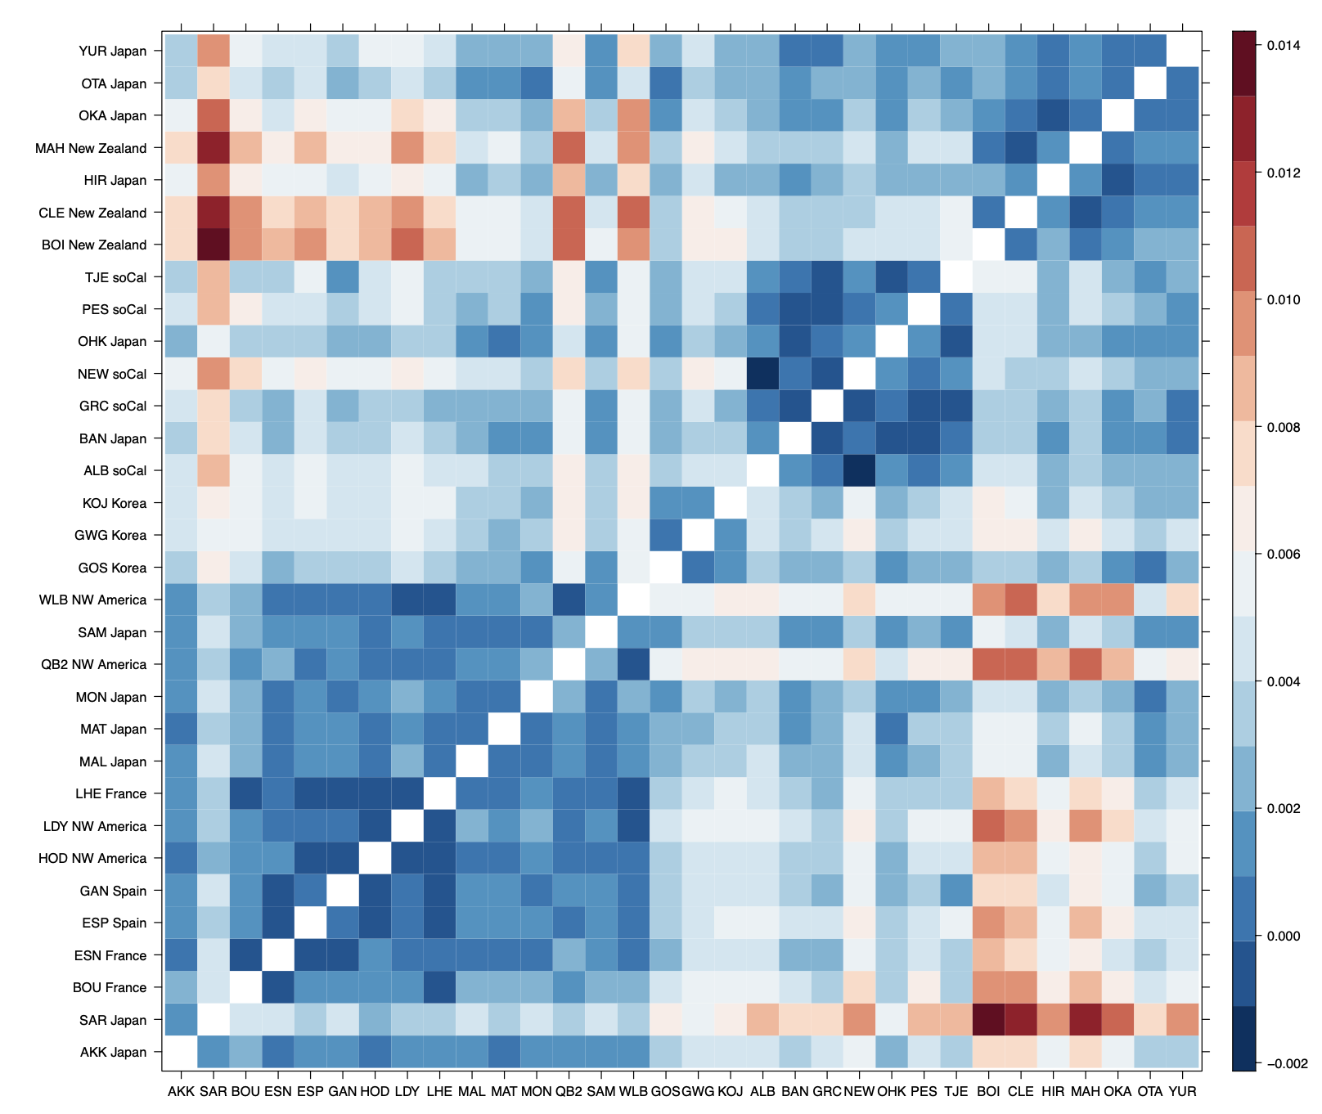
Figure S3 – Heatmap of pairwise Weir & Cockerham PhiSt. Dendrogram via of R::lattice::levelplot().
Southern Japan
New Zealand
Southern California
South Korea
Northern Japan
Canada
Washington State
Spain, France

Slide 6
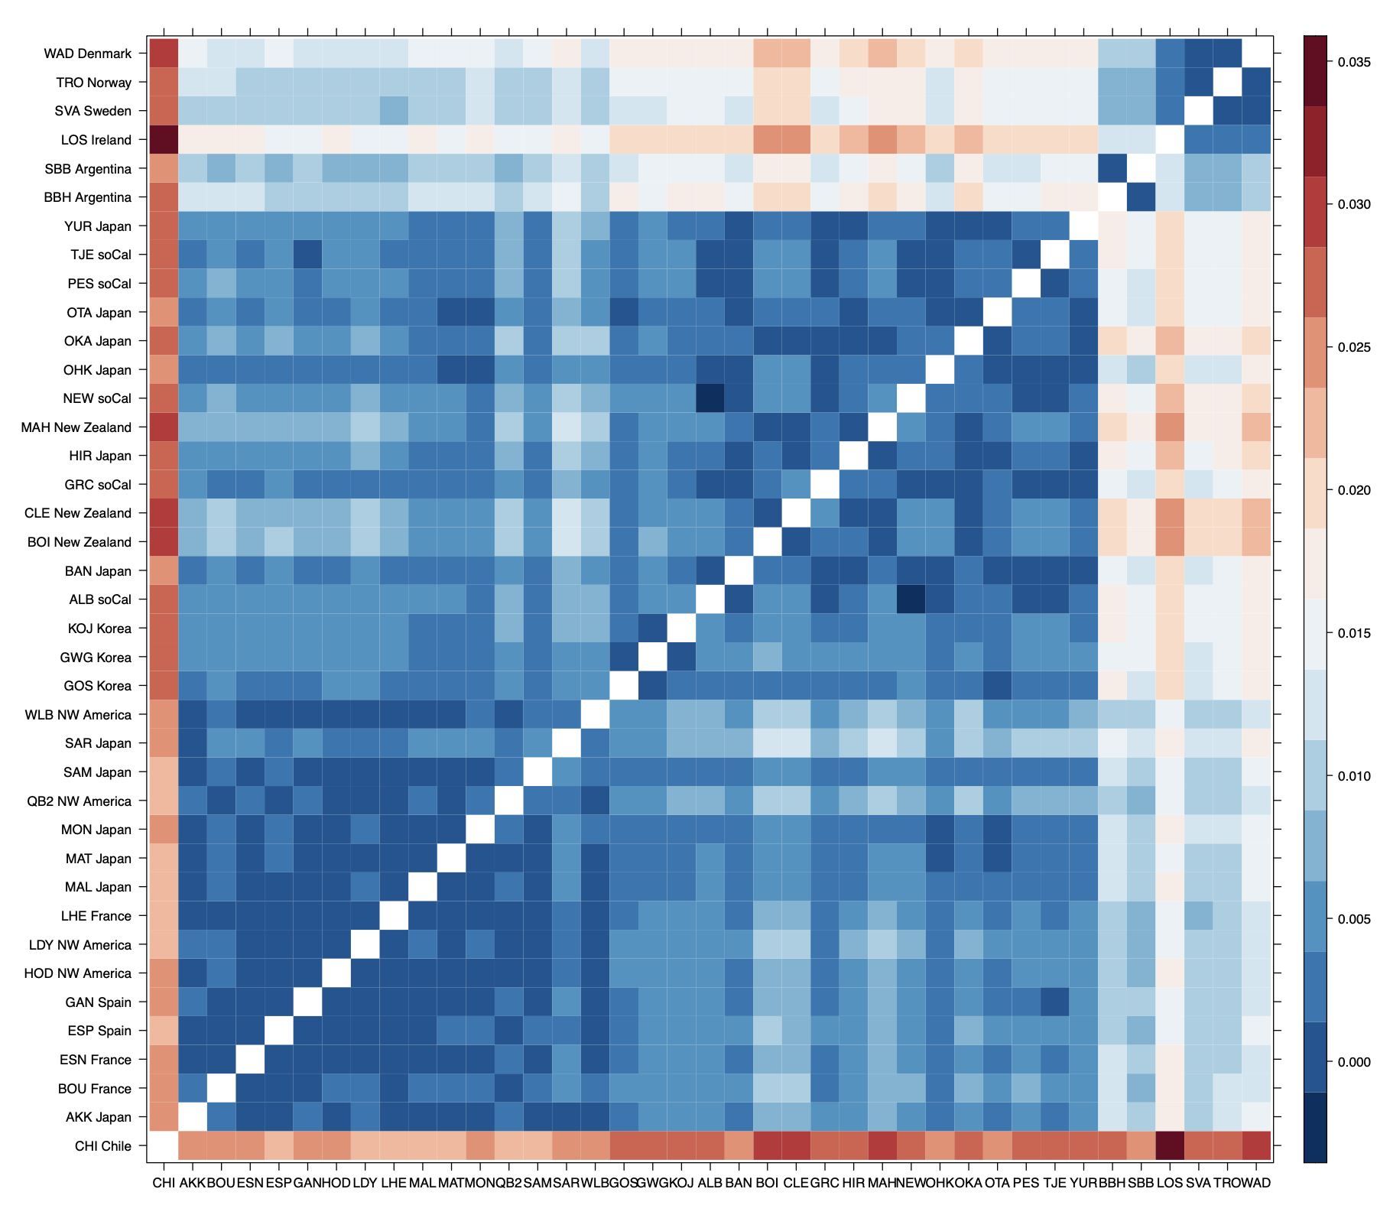
Figure S3 – Heatmap of pairwise Weir & Cockerham PhiSt. Dendrogram via of R::heatmap().
Argentina
Northern Europe
Southern Japan
New Zealand
Southern California
South Korea
Northern Japan
Canada
Washington State
Spain, France

Slide 7
Other

